Slide 1
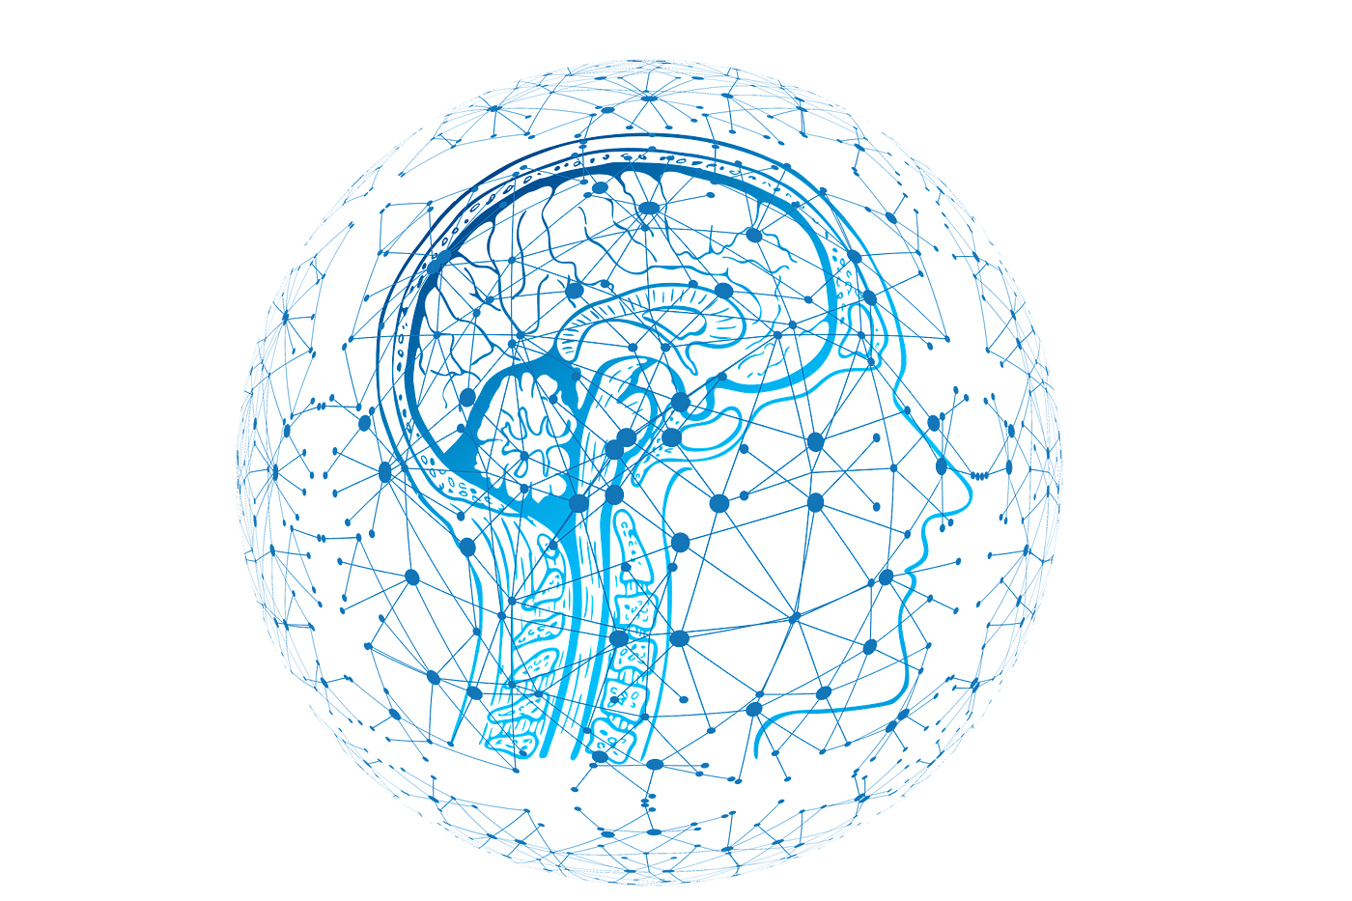
AI Bias in Recruitment
Team 17
Seth Villavicencio, Rohit Bhagavatula, Stavan Bhakta, Kaiwen Yu

Slide 2
How can we identify and mitigate the biases inherent in AI-driven applicant tracking systems to ensure equitable and fair recruitment processes across gender, racial, and age groups?

Slide 3

Research Paper: Ethics and Discrimination in Artificial Intelligence-Enabled Recruitment Practices
Author: Zhisheng Chen, 2023
Strengths:
Thorough Review
Empirical Data
Actionable Solutions
Weaknesses:
Lacks Technical Depth
Limited Case Studies
Broad Solutions
Key Points:
Integration Gap
Relevance
Ethics
Notes:
Our first paper to discuss today is Ethics & Discrimination in Artificial Intelligence-enabled Recruitment Practices written for the Journal of Humanities & Social Sciences, and this paper goes into the discriminatory issues and ethical concerns that exist within AI recruitment by taking an in-depth look at several case studies including the Amazon AI Recruitment Tool, Microsoft Tay, IBM Facial Recognition, and other AI models. It specifically emphasizes the need for not just technical, but also managerial development to prevent bias across the board. Some technical solutions posited include using unbiased data frameworks that include diverse arrays of different candidate information to train the AI Applicant Tracking Systems with, along with more algorithmic transparency and algorithmic auditing, which sets the standard for specific decision criteria across the board in order to make the AI process understandable, along with regular check-ups of the AI algorithm to identify and correct repetitive and discriminatory patterns. On the Managerial side, the paper also goes into the benefits of setting guidelines for the ethical use of AI within company culture as well as various different DEI initiatives to foster a culture of diversity right from the start. After all, you need to know you are biased in order to correct it. Some of the strengths of the paper include its comprehensive review of theories in discrimination to contextualize the bias issue across several industries, and it also employs the use of empirical data through surveys of applicants in real time to back-up conclusions in biased discrimination. That being said, some weaknesses in the paper include its lack of technical depth. While the paper talks extensively about the after effects of biased ATS systems, it fails to go more in depth into the more functional hardware and software components of these systems. On top of this while the paper cites many important case studies, like the Amazon AI recruitment tool, and Microsoft Tay as an example, these case studies only take a look at recruitment within the tech industry and do not include biases that exist in other industries. Finally, the broad solutions the paper posits, while they are actionable, may have a tendency to not be applicable to every single industry, and more tailored solutions to different industries would have greatly strengthened the urgency for such developments to mitigate bias to be made.
Critical points to think about after this paper are the integration gap between theory and practice. As an example, many theoretical models assume data is inherently unbiased and objective, but in reality, data more often than not reflects historic inequalities that have existed throughout time, and thus training models on this data will create heavy bias within any model using said data. On top of this, technology has greatly advanced in the year since this paper was written, so taking into account developments in AI in real time is also another consideration to keep in mind. Now I will hand it off to Seth to discuss our next research paper.
Overview of Selected Paper(s)
Paper Identification:
Title: "Ethics and Discrimination in Artificial Intelligence-enabled Recruitment Practices"
Author: Zhisheng Chen
Publication Year: 2023
Journal: Humanities and Social Sciences Communications
Key Concepts:
Algorithmic Bias: Discusses how biases in AI algorithms can manifest based on the data used for training AI models—particularly focusing on gender, racial, and personality traits biases.
Source of Bias: Identifies the primary sources of these biases as originating both from the data itself (historically biased data sets) and the subjective methodologies employed by algorithm designers.
Mitigation Strategies: Proposes a blend of technical solutions (like unbiased dataset frameworks and improved algorithmic transparency) and managerial measures (including internal ethical governance and external regulatory oversight).
The paper explores the ethical concerns and discrimination issues associated with AI-enabled recruitment, emphasizing the need for both technical and managerial solutions to mitigate algorithmic bias. Key technical strategies include the development of unbiased data frameworks, enhancing algorithmic transparency, and employing technological tools to prevent bias, such as anonymizing candidate data. On the managerial front, the paper advocates for robust internal ethical governance, stringent external oversight, diversity in development teams, and continuous review mechanisms to ensure fair and equitable AI application in recruitment processes. These measures aim to enhance recruitment quality, efficiency, and fairness, aligning AI advancements with ethical standards and social justice.
Strengths of the Paper
Comprehensive Review:
The paper provides a thorough literature review, integrating various theories of discrimination to contextualize the issue within AI-enabled recruitment processes effectively.
It systematically identifies and categorizes types of biases, which is crucial for developing targeted interventions.
Empirical Data Usage:
Utilizes empirical data through surveys, enhancing the credibility of the insights regarding perceptions of AI-driven recruitment applications and discrimination.
This primary data usage helps validate the theoretical assertions made and highlights real-world implications.
Solution-Oriented:
Beyond merely discussing problems, the paper advances practical and actionable solutions for mitigating bias, offering a balanced perspective between technological fixes and policy reforms.
Weaknesses of the Paper
Lack of Technical Depth:
While the paper discusses algorithmic biases, it does not delve deeply into the technical specifics of the AI models or the exact nature of the data biases in technical terms. This lack of detail may leave technically-oriented audiences needing more clarity on how these biases can be practically identified and corrected in AI systems.
Limited Case Studies:
The discussion could be strengthened by the inclusion of specific case studies or examples where biases were successfully mitigated. Real-world applications and the practical challenges faced can provide deeper insights.
Generalization of Solutions:
The solutions proposed, while helpful, are somewhat generic and may not apply universally across different organizational contexts. Tailored solutions based on industry-specific examples could enhance the paper's utility.
Critical Analysis
Integration of Theoretical and Empirical Insights:
Critique how well the paper integrates its theoretical framework with the empirical data gathered. Discuss any gaps in theory and practice highlighted by the study.
Relevance to Current AI Technologies:
Evaluate the relevance of the discussed biases and solutions in the context of rapidly evolving AI technologies. Are the proposed solutions adaptable to new AI paradigms like deep learning and neural networks?
Ethical Considerations:
Critically analyze the ethical frameworks discussed. Are they robust enough to handle emerging ethical dilemmas in AI recruitment? What ethical guidelines are missing, and how might they be effectively incorporated?
Conclusion of Discussion
Summarize the importance of discussing such papers in understanding and addressing AI biases in recruitment.
Highlight the need for ongoing research and adaptation of the solutions proposed to keep pace with technological advancements.
Our first paper to discuss today is Ethics & Discrimination in Artificial Intelligence-enabled Recruitment Practices, and this paper goes into the discriminatory issues and ethical concerns that exist within AI recruitment. It specifically emphasizes the need for not just technical, but also managerial development to prevent bias across the board. Some technical solutions posited include using unbiased data frameworks that include diverse arrays of different candidate information to train the AI Applicant Tracking Systems with, along with more algorithmic transparency and algorithmic auditing, which sets the standard for specific decision criteria across the board in order to make the AI process understandable, along with regular check-ups of the AI algorithm to identify and correct repetitive and discriminatory patterns. On the Managerial side, the paper also goes into the benefits of setting guidelines for the ethical use of AI within company culture as well as various different DEI initiatives to foster a culture of diversity right from the start. After all, you need to know you are biased in order to correct it. Some of the strengths of the paper include its comprehensive review of theories in discrimination to contextualize the bias issue across several industries, and it also employs the use of empirical data through surveys of applicants in real time to back-up conclusions in biased discrimination. That being said, some weaknesses in the paper include its lack of technical depth. While the paper talks extensively about the after effects of biased ATS systems, it fails to go more in depth into the more functional hardware and software components of these systems. On top of this while the paper cites many important case studies, like the Amazon AI recruitment tool, and Microsoft Tay as an example, these case studies only take a look at recruitment within the tech industry and do not include biases that exist in other industries. Finally, the broad solutions the paper posits, while they are actionable, may have a tendency to not be applicable to every single industry, and more tailored solutions to different industries would have greatly strengthened the urgency for such developments to mitigate bias to be made.
Critical points to think about after this paper are the integration gap between theory and practice. As an example, it is widely believed that data is inherently unbiased and objective, but in reality, data more often than not reflects historic inequalities that have existed throughout time, and thus training models on this data will create heavy bias within any model using said data. On top of this, technology has greatly advanced in the year since this paper was written, so taking into account developments in AI in real time is also another consideration to keep in mind. Now I will hand it off to Seth to discuss our next research paper.

Slide 4

Research Paper Analysis: Ethical Considerations in AI-Based Recruitment
Authors: Dena F. Mujtaba & Nihar R. Mahapatra, 2019
Key Concepts:
Definitions of fairness
Origins & mitigation of bias
Strengths:
Comprehensive Coverage
Real-World Examples
Future Outlook
Weaknesses:
Lack of Empirical Data
Cultural Considerations
Accessibility
Critical Insights:
Theory vs. Practice
?
Notes:
Research Paper Discussion: Ethical Considerations in AI-Based Recruitment
Clear, Accurate, and Thoughtful Critiques
Key Concepts Presented:
Fairness Definitions and Bias Mitigation: The paper offers an extensive overview of fairness in machine learning within the recruitment context, highlighting various definitions of fairness (demographic parity, accuracy parity, predictive rate parity, individual fairness, and counterfactual fairness).
Bias Origins and Mitigation: Discussion on how biases are transferred from human-generated datasets to AI models and the techniques to mitigate these biases through pre-processing, in-processing, and post-processing methods.
Strengths of the Paper:
Comprehensive Scope:
The paper effectively maps the landscape of AI-based recruitment, detailing both the technological advancements and their ethical implications.
It provides a holistic view by integrating theories of fairness, methods of bias detection, and mitigation strategies.
Practical Relevance:
Mujtaba and Mahapatra focus on practical tools for bias mitigation, making this paper highly relevant for developers and HR professionals looking to implement fair AI systems.
The use of real-world examples, like Amazon’s biased hiring tool, illustrates the direct implications of these ethical considerations.
Future-Oriented:
The discussion extends beyond current methodologies to future challenges and the continuous evolution of fairness in AI recruitment, providing a forward-thinking perspective.
Weaknesses of the Paper:
Lack of Empirical Data:
The paper primarily discusses theoretical aspects and lacks empirical research to support the claims. This could be supplemented with more case studies or proprietary data analysis.
Limited Discussion on Cultural and Global Impact:
While the paper covers a broad range of biases and mitigation tools, it does not extensively explore the cultural or global variations in bias, which can be crucial in multinational companies.
Complexity and Accessibility:
The technical content and the depth of analysis might be inaccessible to readers without a background in machine learning or ethics, potentially limiting its audience.
Critical Analysis:
Integration of Theory and Practice:
The paper does an excellent job at bridging theoretical fairness definitions with practical mitigation strategies. However, the impact of these strategies in real-world scenarios could be better illustrated through more detailed success stories or data-driven outcomes.
Adaptability to New AI Advances:
As AI technologies evolve, the adaptability of proposed fairness tools and methods could be further examined. The paper could discuss how these tools might cope with newer forms of AI, such as deep learning or neuroevolutionary algorithms.
Ethical Depth:
The paper provides an ethical framework for AI recruitment but could delve deeper into the philosophical underpinnings of "fairness" and "bias". This would strengthen the discussion by situating AI ethics within broader ethical debates in technology.
Conclusion of Discussion
This research paper is a critical asset for understanding the ethical landscape of AI in recruitment. It not only illuminates the complexities of implementing fairness but also provides a comprehensive toolkit for practitioners. The identified weaknesses offer avenues for further research and refinement, ensuring that the discourse on AI ethics remains dynamic and responsive to technological changes.

Slide 5
Technical Coding Demonstration
https://colab.research.google.com/drive/14nUVSWp5ARMgEohUx4tV75fhtarlQoBT?usp=sharing

Slide 6
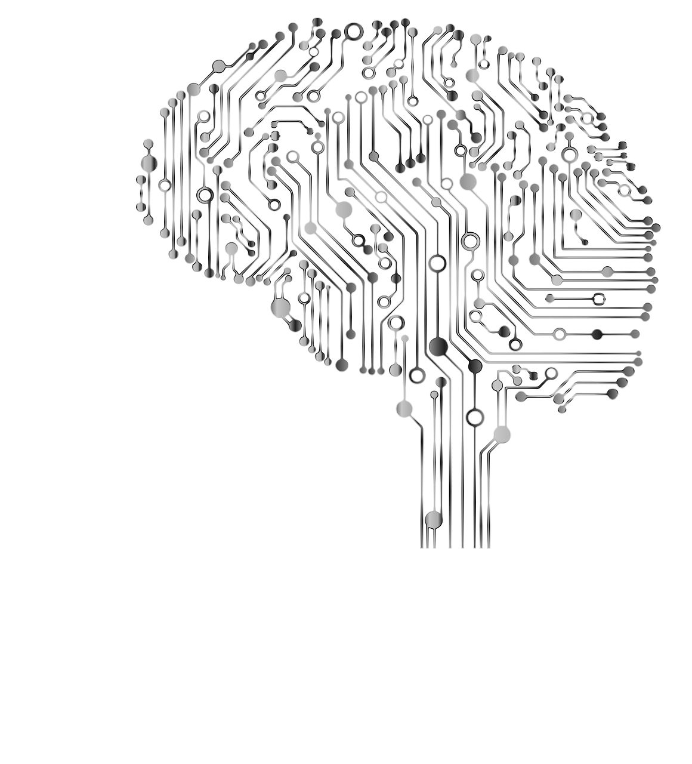
Ethical Concerns in AI-Enabled Recruitment
Bias and Fairness:
Inherent Biases, Flawed Data.
Impact on Fairness
Transparency:
Algorithmic Opacity; "Black Box" Issue
Need for Explainability
Accountability:
Responsibility
Legal and Policy Frameworks
Privacy:
Data Handling
Balance
Societal Impact:
Reinforcing Inequalities
Mitigation Strategies
Notes:
4. Ethical Discussion: Key Ethical Issues in AI-enabled Recruitment
Fundamental Ethical Concerns:
Bias and Fairness:
Discuss the ethical implications of biases inherent in AI systems, particularly those related to gender, race, and age.
Explore how such biases can lead to unfair hiring practices, impacting individuals' employment opportunities based on non-merit factors.
Transparency:
Highlight the need for transparency in AI algorithms used for recruitment to ensure that candidates and regulators understand how decisions are made.
Question the opacity of AI systems, often referred to as "black boxes," and discuss the ethical necessity for explainable AI.
Accountability:
Address who is responsible when AI systems perpetuate bias—Is it the AI developers, the company using the ATS, or the data providers?
Explore the mechanisms for holding parties accountable, including legal and organizational policies.
Privacy:
Consider the ethical issues surrounding the collection, storage, and analysis of personal data by AI in recruitment.
Discuss the balance between enhanced recruitment processes and the potential for privacy infringements.
Broader Ethical Questions:
Autonomy vs. Automation: Delve into the ethical debate between enhancing hiring efficiency through automation and maintaining human autonomy in the recruitment process.
Societal Impact: Reflect on how widespread use of biased AI in recruitment could reinforce societal inequalities and what measures can be implemented to prevent such outcomes.
Slide 6: Ethical
Today, as we consider the deployment of AI in recruitment, we face several ethical concerns that need our attention and action.
First, we must address Bias and Fairness. AI systems are only as good as the data they are trained on, and historically, this data can carry inherent biases that impact decision-making fairness. Recognizing and correcting these biases is fundamental to ethical AI use.
Transparency is another major concern. Often referred to as the "Black Box" issue, the opacity of AI algorithms can make it difficult to understand how decisions are made. This lack of explainability is a barrier to trust and accountability.
Which brings us to Accountability itself. Who is responsible when an AI recruitment tool makes a discriminatory decision? Clear legal and policy frameworks must be developed to address these challenges.
Privacy must also be safeguarded, balancing effective data use with respect for individual privacy rights.
Lastly, the Societal Impact of AI tools, such as reinforcing existing inequalities, must be actively mitigated through thoughtful design and implementation of these technologies.

Slide 7

What’s Next? – Future Developments and Concerns in AI-Enabled Recruitment
Technological Advancements:
Advanced Neural Networks
Integrated AI Systems
Evolving Concerns:
Deepening Data Complexity
Algorithmic Transparency
Regulatory Landscape:
Stricter Regulations
Ethical Audits
Innovative Uses:
Holistic Candidate Assessment
Bias Correction Algorithms
Notes:
Technological Advancements:
Advanced Neural Networks: Adoption of more complex models that can process nuanced human characteristics more ethically.
Integrated AI Systems: Seamless integration of AI across all recruitment phases with real-time bias monitoring.
Evolving Concerns:
Deepening Data Complexity: As data sources broaden, ensuring the ethical handling and interpretation of this data becomes more challenging.
Algorithmic Transparency: Moving towards fully interpretable AI models to comply with evolving global regulations on AI transparency.
Regulatory Landscape:
Stricter Regulations: Anticipate tighter controls and standards from governments worldwide, especially concerning bias and fairness in AI.
Ethical Audits: Routine ethical audits of AI systems may become standard practice to ensure compliance and fairness.
Innovative Uses:
Holistic Candidate Assessment: AI tools that assess candidates beyond traditional metrics, considering personality, adaptability, and potential.
Bias Correction Algorithms: Development of self-correcting algorithms that automatically adjust their processes to eliminate biases detected.
Slide 7: What’s Next?
Looking forward, the landscape of AI in recruitment is both promising and fraught with challenges. Technological advancements like more sophisticated neural networks and integrated AI systems offer the potential for more accurate and holistic assessments of candidates.
However, these technologies also bring Evolving Concerns such as deepening data complexity and the need for greater transparency in algorithm to ensure fairness and ethical compliance.
The Regulatory Landscape is likely to become stricter, incorporating more rigorous ethical audits and regulations designed to safeguard both individuals and society.
Innovation continues to drive forward, with new approaches like Bias Correction Algorithms and holistic candidate assessment tools that aim to reduce discrimination and enhance the hiring process.
As we move forward, it is imperative that we navigate these developments with a careful balance of innovation, ethical consideration, and regulatory oversight to truly harness the potential of AI in enhancing recruitment practices while safeguarding fundamental human rights.

Slide 8
References
Chen, Z. (2023, September 13). Ethics and discrimination in artificial intelligence-enabled recruitment practices. Nature News. https://www.nature.com/articles/s41599-023-02079-x#:~:text=The%20findings%20suggest%20that%20AI,%2C%20color%2C%20and%20personality%20traits
Christian, B. (2020). The alignment problem: Machine Learning and human values. Norton & Company.
IBM Data & AI Team. (2023, October 16). Shedding light on AI bias with real world examples. IBM Blog. https://www.ibm.com/blog/shedding-light-on-ai-bias-with-real-world-examples/
Mujtaba, D., & Mahapatra, N. (2019). Ethical Considerations in AI-Based Recruitment. IEEE Xplore. https://ieeexplore.ieee.org/abstract/document/8937920
Notes:
Chen, Z. (2023, September 13). Ethics and discrimination in artificial intelligence-enabled recruitment practices. Nature News. https://www.nature.com/articles/s41599-023-02079-x#:~:text=The%20findings%20suggest%20that%20AI,%2C%20color%2C%20and%20personality%20traits
Christian, B. (2020). The alignment problem: Machine Learning and human values. Norton & Company.
IBM Data & AI Team. (2023, October 16). Shedding light on AI bias with real world examples. IBM Blog. https://www.ibm.com/blog/shedding-light-on-ai-bias-with-real-world-examples/
Mujtaba, D., & Mahapatra, N. (2019). Ethical Considerations in AI-Based Recruitment. IEEE Xplore. https://ieeexplore.ieee.org/abstract/document/8937920

